Slide 1
WINDOWS INSTALLATION
Chapter 5

Slide 2

Objective
5.1 Modern Operating System
Explain operating system requirements.
5.2 Operating System Installation
Install a Microsoft Windows operating system.

Slide 3
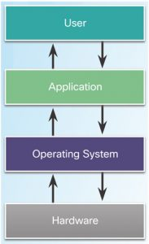
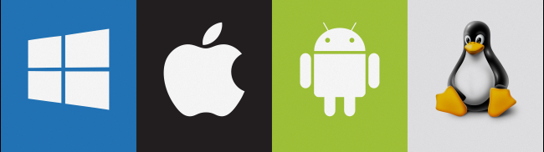
5.1 Modern Operating Systems
An operating system is system software that manages computer hardware, software resources, and provides common services for computer programs

Slide 4
5.1.1 Operating System Terms and Characteristics
Terms
Common terms describing operating systems include: multi-user, multitasking, multiprocessing and multithreading
Basic Functions of an Operating System (OS)
Hardware Access
File and Folder Management
User Interface (CLI and GUI)
Application Management
Processor Architecture
Affects the performance of the computer.
CPUs contain storage locations called registers.
Registers can be 32-bits or 64-bits long.

Slide 5
5.1.2 Types of Operating Systems
Desktop Operating Systems
• Intended for use in SOHO environment.
• Supports a single user.
• Shares files and folders on a small network with limited security.
• Microsoft Windows, Apple Mac OS, and Linux are a few examples.
Network Operating Systems
• Contains features that increase functionality in a networked environment
• Supports multiple users.
• Provides increased security compared to desktop operating systems
Notes:
SOHO = small office/home office

Slide 6
5.1.3 Customer Requirements for an Operating System
OS Compatible Applications and Environments
Before recommending an OS, the technician must:
• Review budget constraints.
• Learn how the computer will be used.
• Determine which types of applications will be installed.
• Determine if a new computer needs to be purchased?
Minimum Hardware Requirements and Compatibility with the OS Platform
• The OS minimum requirements must be met for optimal operation.
• Some applications may also have specific hardware requirements.
• Upgrades may be necessary.
• RAM, hard drives, CPU, video card, motherboard are a few common upgradable components.
• Microsoft Compatibility Center can be a good resource.
Notes:
SOHO = small office/home office

Slide 7
5.1.4 Operating Systems Upgrade
Checking OS Compatibility
• New version of an OS brings new functionality and better performance.
• Support for older hardware may be dropped.
• New hardware may require latest OS versions.
• Check OS compatibility before upgrading the OS.
• Microsoft’s Upgrade Assistant and Upgrade Advisor can be helpful tools.
Windows OS Upgrades
• Upgrading Windows may be faster than performing a full install.
• The installed version of an OS determine the upgrades options.
• A full data backup is recommended before upgrading.
Notes:
SOHO = small office/home office

Slide 8
Data Migration
• User data must be transferred after a new installation.
• User State Migration Tool and Windows Easy Transfer are tools designed to help the transfer process.
5.2 Operating System Installation
Install Operating system is simple ever than before. You may need a CD OS or USB boot that contain OS which is prefer and faster.
5.2.1 Storage Device Setup Procedures
You may need to consider some options or features to choose when install new operating system.
Notes:
SOHO = small office/home office

Slide 9
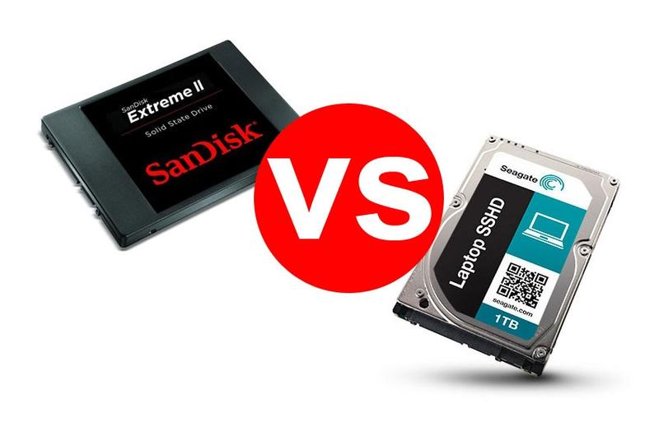
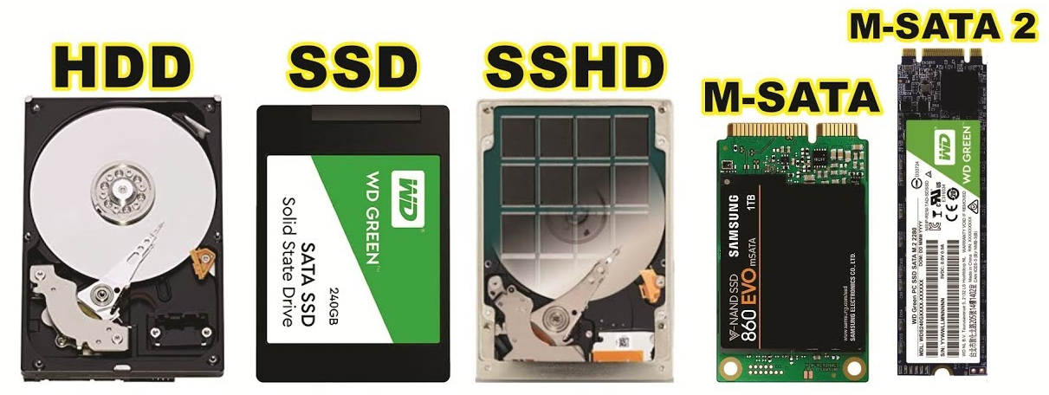
Storage Device Types
Hard Disk Drives
Flash Memory-Based Drives (USB Flash Drives, SSDs, SSHDs and eMMC)
SSD: solid state drive
SSHD: solid-state hybrid drive
eMMC: Embedded Multimedia Card or is more affordable and slower Flash-based storage than solid state drives.
Notes:
SSHD stand for solid-state hybrid drive

Slide 10
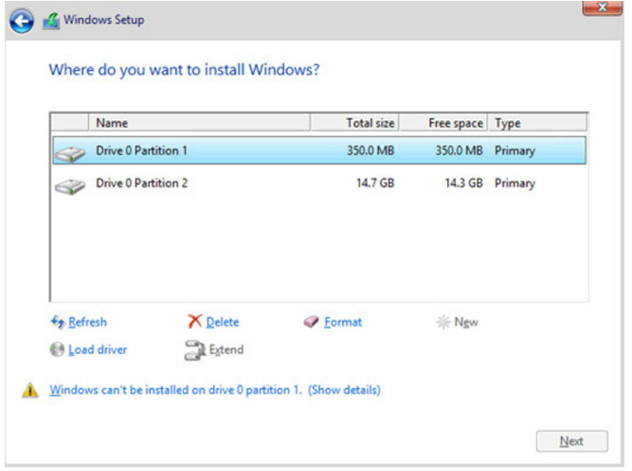
Hard Drive Partitioning
Logical divisions inside a disk.
Proper partitioning is crucial for a correct boot process.
MBR and GPT are the two most popular partition scheme standards.
File Systems
File systems define how data is written within a partition.
Different OSs, support different file systems.
FAT32, NTFS, exFAT, CCFS and NFS are common file systems supported by Windows-based OSs.

Slide 11
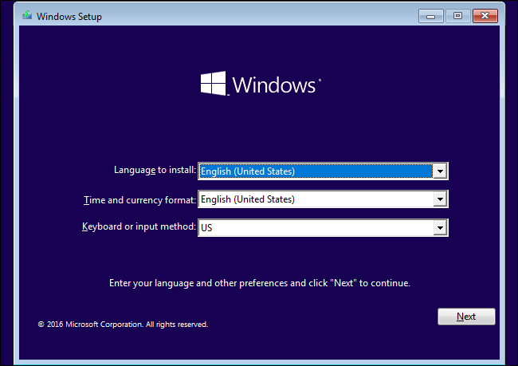
OS Installation with Default Settings
• The installer program applies the most common settings.
• Preferred by inexperienced users.
• Allows for very little customization.
• Windows allows for granular customization after the default setting installation is complete.
Account Creation
• User accounts allow multiple users to share a computer.
• Common Windows account types are Administrator, Standard, and Guest.

Slide 12
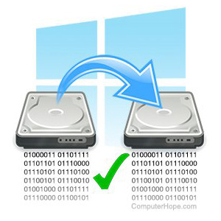
5.2.2 Custom Installation Options
Disk Cloning
• Good solution to speed up bulk
installations
• Uses a single OS installation as base
system to create multiple clone systems.
Other Installation Methods
• Windows has several different types of Custom Installations including network installation and image-based installation.
• Other types of Custom Installations include Windows Advanced Startup Options, Refresh your PC (Windows 8.x only), System Restore, Upgrade, Repair installation, Remote network installation, Recovery partition, and Refresh/restore.

Slide 13
Network Installation
• Relies on a network connection to deploy the installation files.
• Network Installation methods include Remote Network Installation and Unattended Installation.
Restore, Refresh, and Recover
• Some tools are also used to perform Custom Installations
• These tools include Windows System Restore, Windows Refresh your PC, and Windows Recovery Partition.
System Recovery Options
• Used to recover after a system failure.
• Popular recovery tools are:
• Windows Advanced Startup Options (Win 8.x)
• System Recovery Options (Windows 10, 7 & Vista)
• Factory Recovery Partition

Slide 14
5.2.3 Boot Sequence and Registry Files
Windows Boot Process
• Common boot steps are: POST execution, locating and loading CMOS configurations, locating and loading bootloaders, locating and loading the OS.
• Windows Boot Loader and Windows Boot Manager are programs used to manage Windows startup.
Startup Modes
• Windows Startup Modes allow for troubleshooting when Windows fails to start.
• Windows Startup Modes include: Safe Mode, Safe Mode with Networking, Safe Mode with Command Prompt and Last Known Good Configuration.

Slide 15
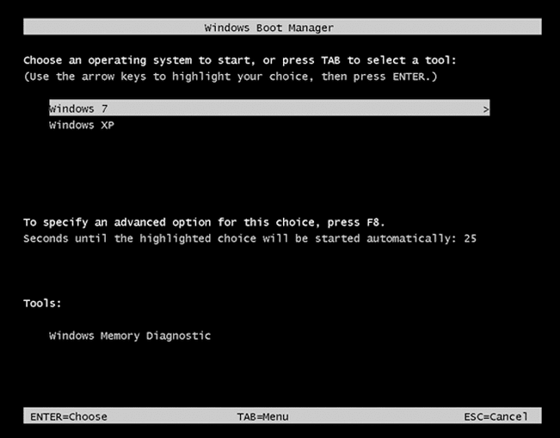
Windows Registry
• All Windows settings are stored as key-values pairs in the Windows Registry
• Extreme caution must be taken when working with the Registry.
5.2.4 Multiboot
Multiboot allow users to switch to different OS on one computer.
Multiboot Procedures
• It is possible to install multiple
OSs in one computer.
• BOOTMGR manages multiple
versions of Windows installed on
a single computer.

Slide 16
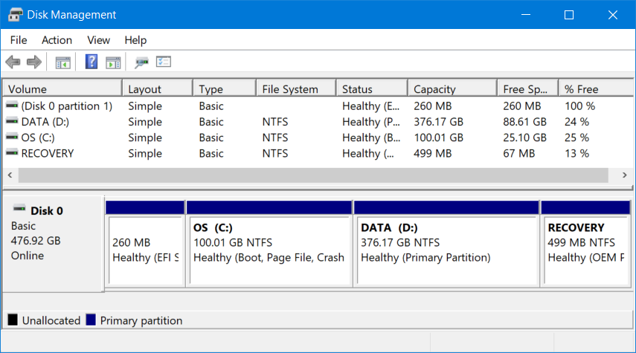
Disk Management Utility
• Many tasks can be accomplished through Disk Management Utility, including: view drive status, extend partitions, split partitions, assign drive letters, add drives and add arrays.

Slide 17
Partitions
• Logical divisions created inside a drive to host file systems.
• Partitions can be extended or shrunk using the Disk Management Utility
Drive Mapping or Drive Letter Assignment
• In Windows, assigning letters to name physical or logical drives is called drive mapping or drive letter assignment.
• Disk Management Utility can also be used to manage drive letter assignment.

Slide 18
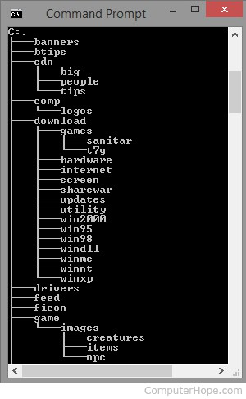
5.2.5 Disk Directories
a directory is a file system cataloging structure which contains references to other computer files, and possibly other directories.
On many computers, directories are known as folders, or drawers, analogous to a workbench or the traditional office filing cabinet.
Directory Structures (Folder Structure)
• Designed to store files and folders.
• A disk must be initialized and formatted if Windows cannot recognize its file systems.
• Formatting a disk or partition creates a file system.
• Formatted disks or partitions must be mounted before use.

Slide 19
User and System File Locations
• System files are files critical to the OS operation.
• User files are files belonging to a user and of little significance to the OS.
Attributes
File extensions identify file types in Windows and must adhere to Windows Naming Convention.
File attributes define how files can be handled.
Common file attributes are READ, ARCHIVE, SYSTEM and HIDDEN.

Slide 20
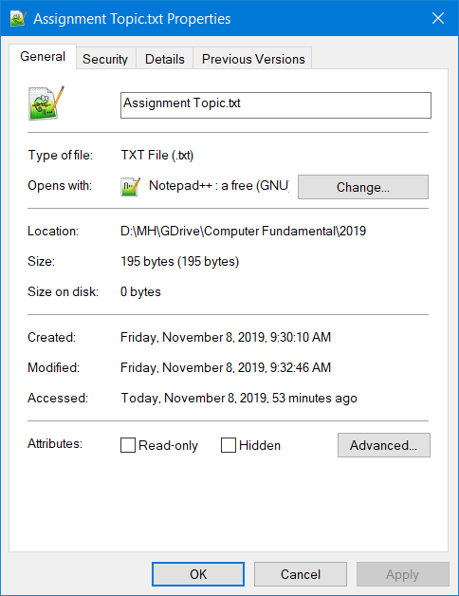
Application, File, and Folder Properties
• Right-click on a file, application or folder to see its properties.
• Application and File Properties are different than Folder Properties.

